Slide 1
JUMP CP
Making sense of Data

Slide 2
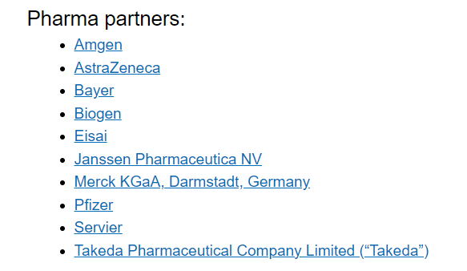
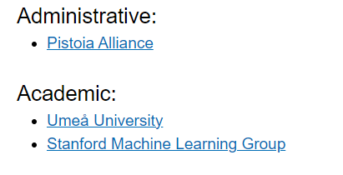
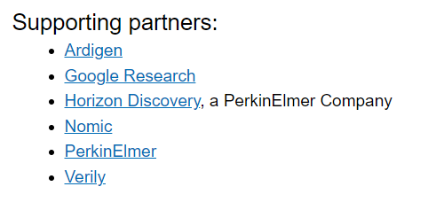
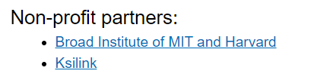
Description

Slide 3
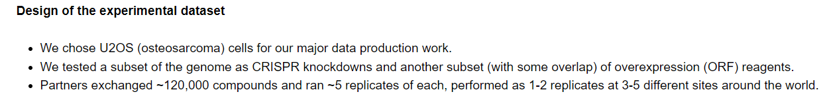
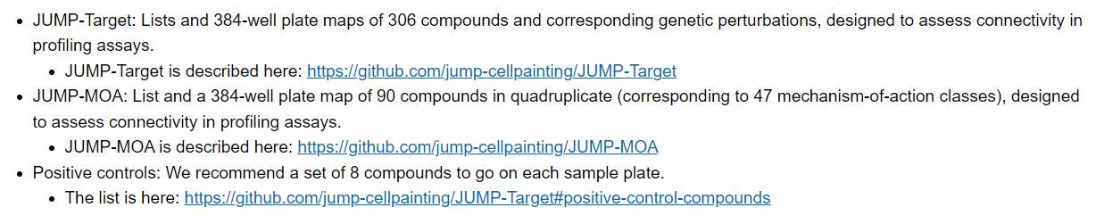
Design

Slide 4
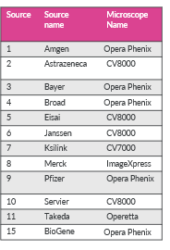
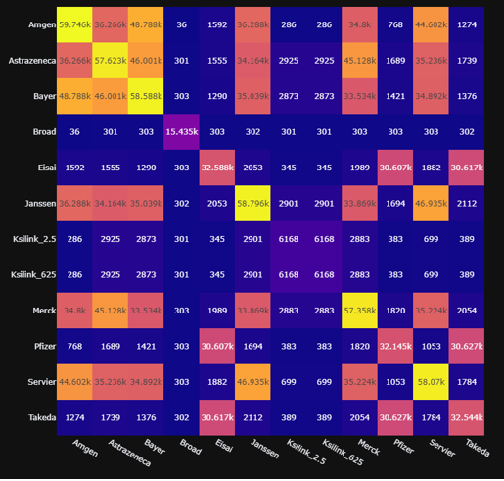
Sources / Microscopes
Intersection between Sources (unique)

Slide 5
In House Dataset
6200 Unique Cpds in 5 replicates and 2 Concentrations (2.5 and 0.625 um)
CRISPR-CAS Druggable genome (7000 in 5 replicates)
More than 100K points

Slide 6


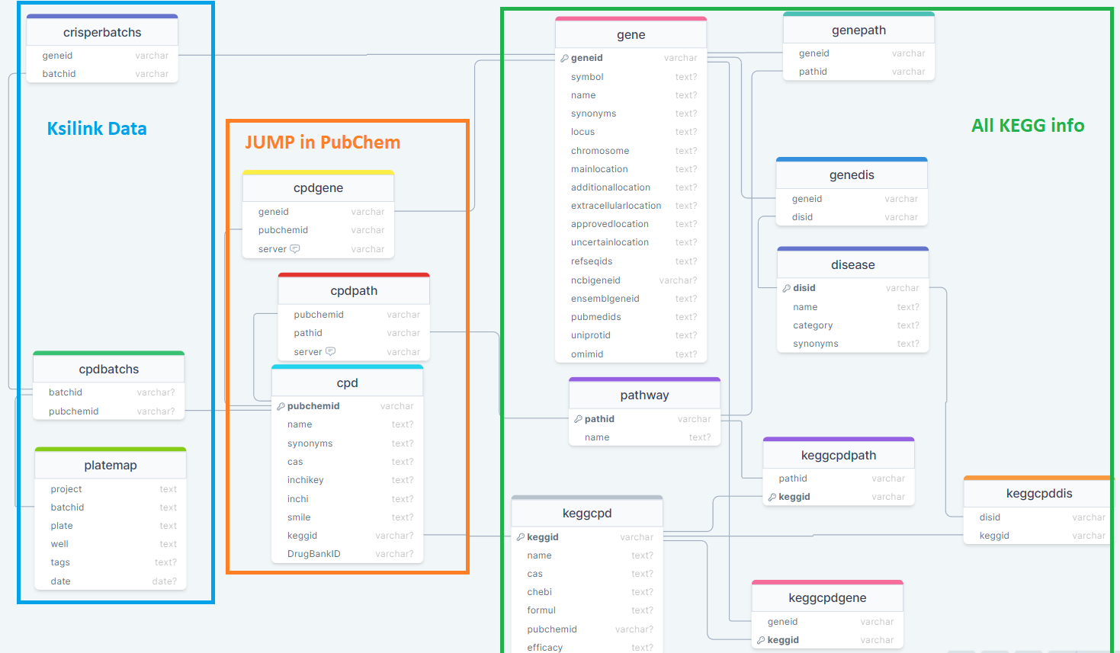


Ksilink Databases
Jump AggProfiles DB
Historical Ksilink DB (in progress)

Slide 7
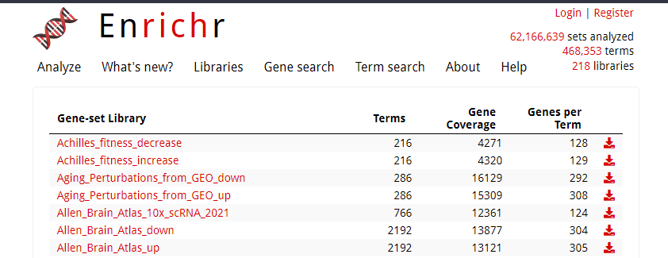
Enrichr Embedded
https://maayanlab.cloud/Enrichr/#libraries

Slide 8

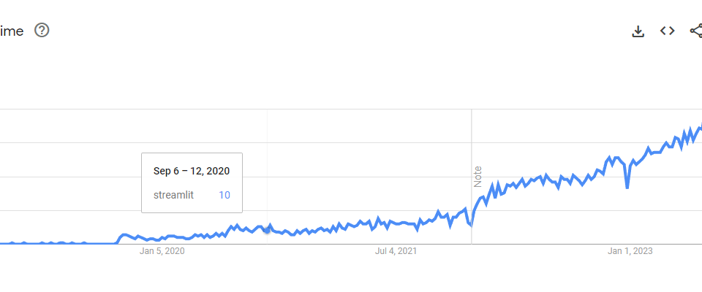
WebApp Interface

Slide 9
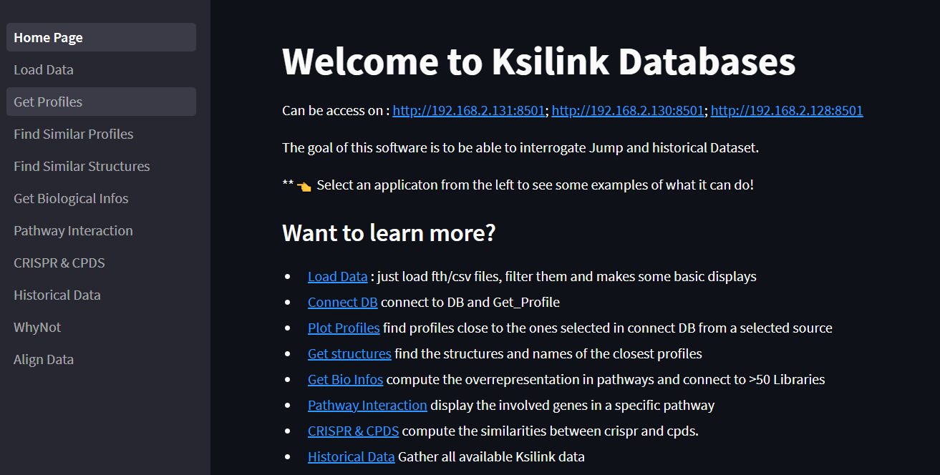

Slide 10
Utilizing JUMP_CP Data to Enrich Hit Compounds.
DM1 : 127 compounds
PD : 57 compounds
DM1
name | profile sim | target | structerre sim | smile
RG2833 | 0.878604017 | HDAC | 0.3 | Cc1ccc(C(=O)NCCCCCC(=O)Nc2ccccc2N)cc1
CAY10603 | 0.901421639 | HDAC | 0.22 | CC(C)(C)OC(=O)Nc1ccc(-c2cc(C(=O)NCCCCCCC(O)=NO)no2)cc1
JCP2022_086584 | 0.902807129 | HDAC | 0.09 | Nc1cc(F)ccc1NC(=O)c1ccc(CNC(=O)C=Cc2cccnc2)cc1
AR-42 | 0.932925381 | HDAC | 0.14 | CC(C)C(C(=O)Nc1ccc(C(O)=NO)cc1)c1ccccc1
Abexinostat | 0.905684625 | HDAC | 0.1 | CN(C)Cc1c(C(=O)NCCOc2ccc(C(O)=NO)cc2)oc2ccccc12

